Slide 1

Time series & forecasting of number of International Passengers Flying to USA via foreign carrier over a month
By,
Jitendra Patel (654254073)

Slide 2
Contents
1. Introduction
2. Analysis of raw data: Plotting & evaluation
3. Splitting the data in Training & testing data
4. Modeling Procedure
4.1. Fitting the Deterministic Trend of the data
4.2. Specifying and Modeling the Stochastic Part
4.3. Jointly Optimizing the Integrated Model
5. Model Diagnostics on the Integrated Model
5.1. Checking stability of jointly estimated ARMA(2,2) model
5.2. Comparison of the Jointly Optimized Model and Actual Data
5.3. Analysis of Residuals Obtained from the Integrated Model
6. Forecasting
7. Conclusion

Slide 3
Introduction
The ability to model and perform decision modeling and analysis is an essential feature of many real-world applications ranging from emergency medical treatment in intensive care units to military command and control systems.
With Tourism becoming one of the essential contributor to country’s economy. It is important to concentrate & facilitate Tourists & Transportation.
With the stiff competition across Aviation industry, no company can afford to lose their passengers.
The future data predictions for number of passengers, their favorite destinations, period preference, etc. can definitely help a company to set their best bets & improve their business.

Slide 4
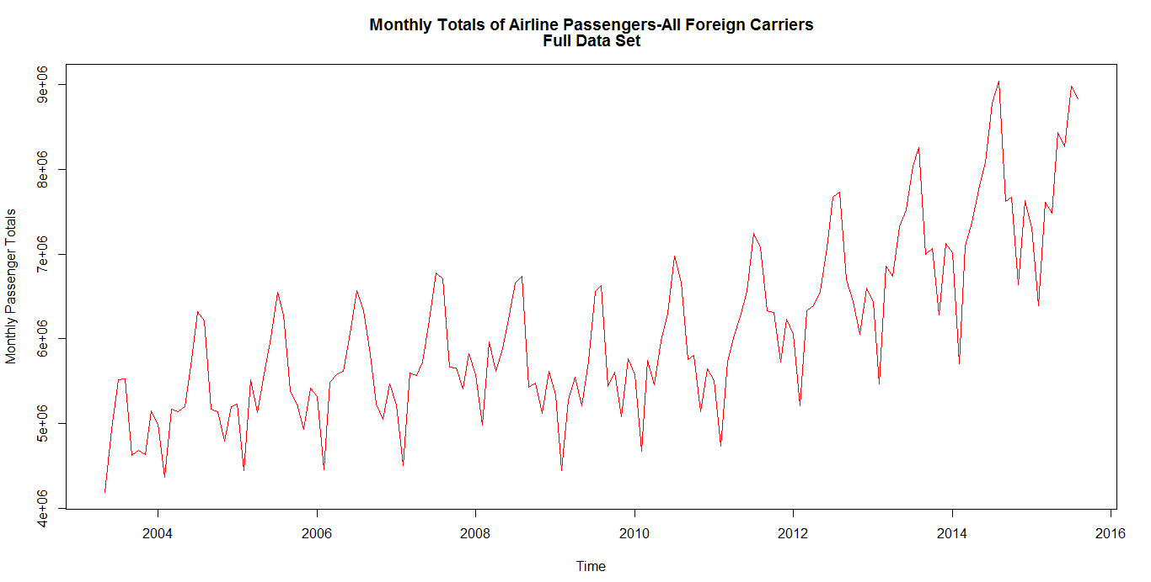
How our data plot looks like
148 Data Points in total
Training Data (90%)
Test
Data

Slide 5
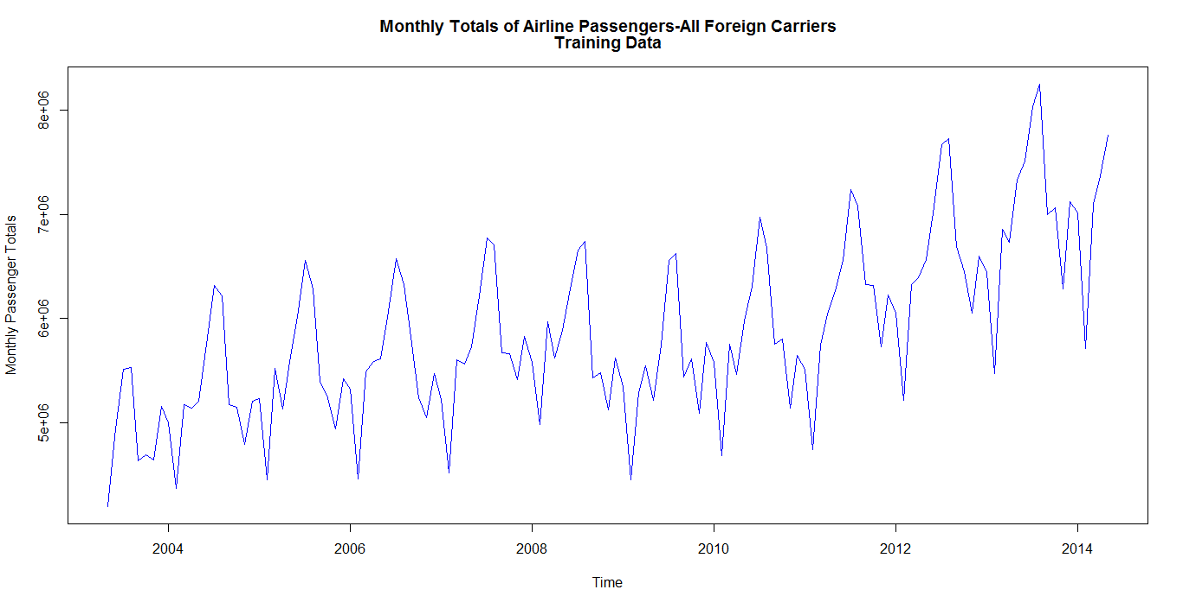
Training Data Set

Slide 6
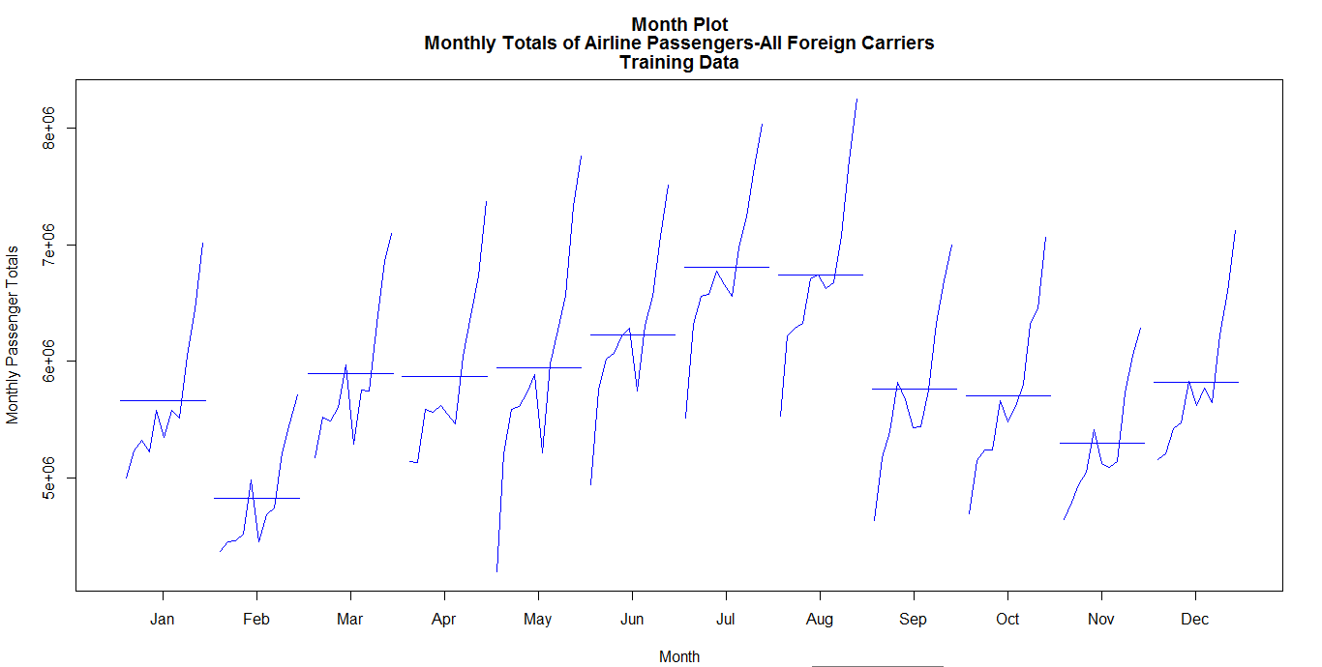
Evaluation of Raw Data
A) Month Plot

Slide 7
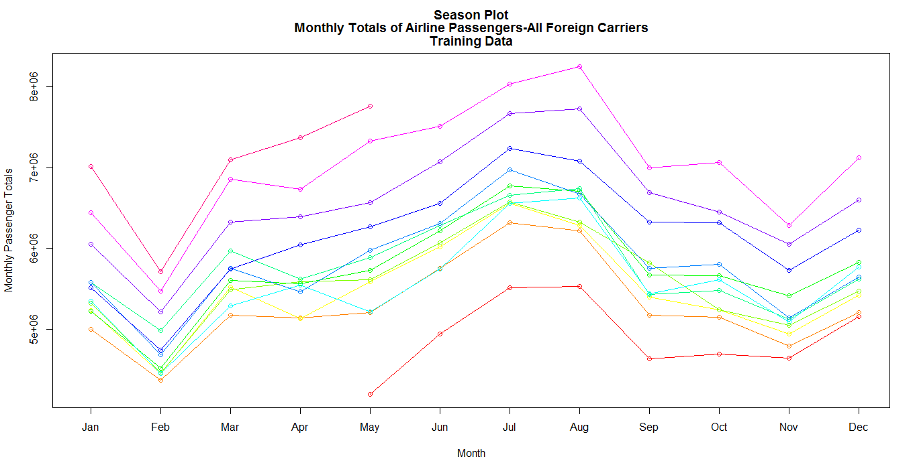
B) Season Plot

Slide 8
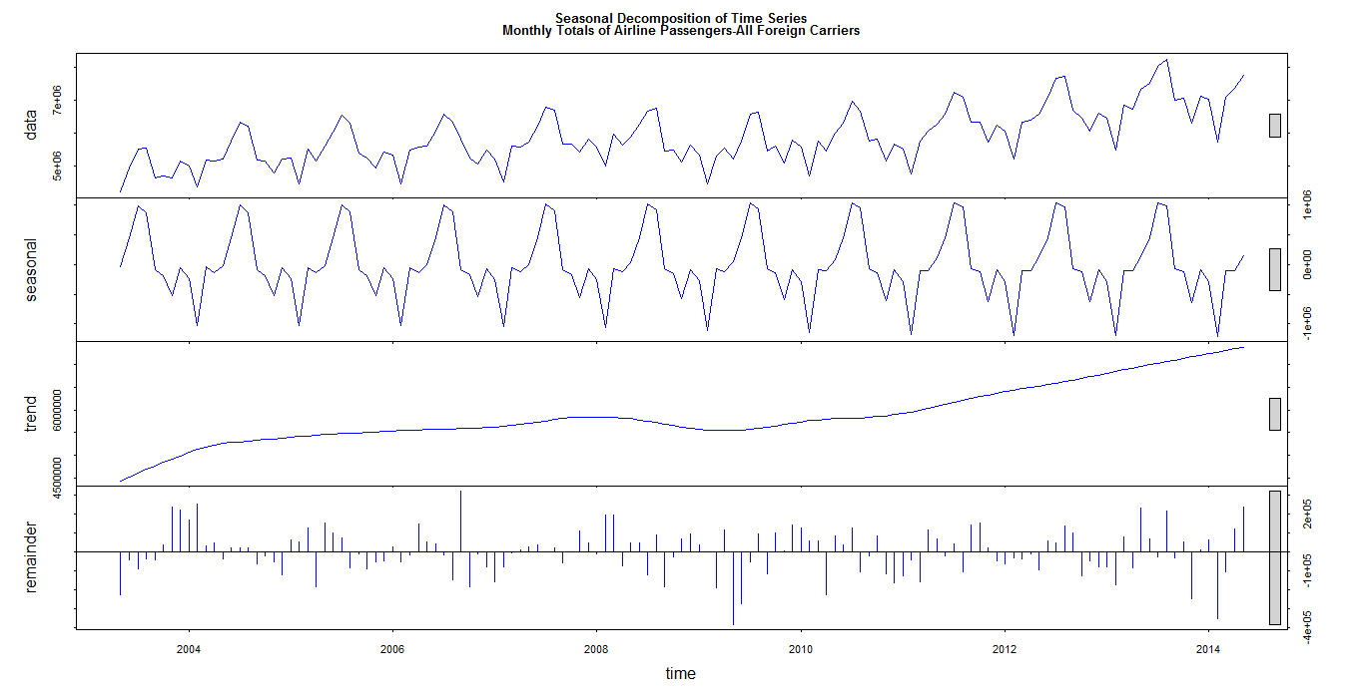
C) Seasonal Trend Decomposition Plot
Seasonal Portion = 28.1%
Deterministic Portion = 83.5%
Trend Portion
= 55.4%
Residuals
= 11.9%

Slide 9
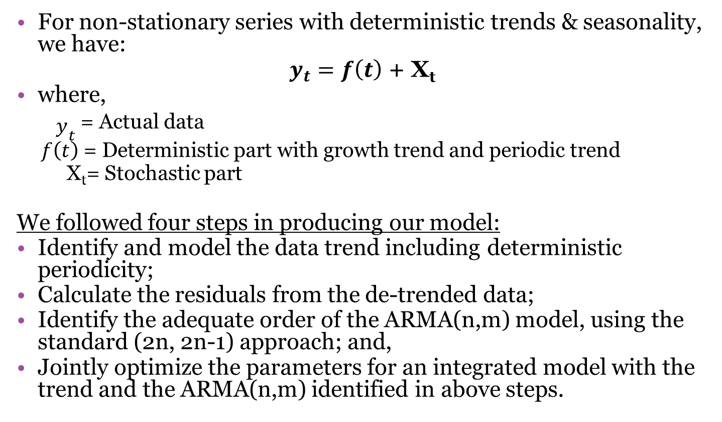
MODELING PROCEDURE
For non-stationary series with deterministic trends & seasonality, we have:
$y_{t}=f\left(t\right)$ + X_{t}
where,
${\begin{aligned} \\ y\end{aligned}}_{t}$= Actual data
$f\left(t\right)$= Deterministic part with growth trend and periodic trend
X_{t}= Stochastic part
We followed four steps in producing our model:
Identify and model the data trend including deterministic periodicity;
Calculate the residuals from the de-trended data;
Identify the adequate order of the ARMA(n,m) model, using the standard (2n, 2n-1) approach; and,
Jointly optimize the parameters for an integrated model with the trend and the ARMA(n,m) identified in above steps.

Slide 10
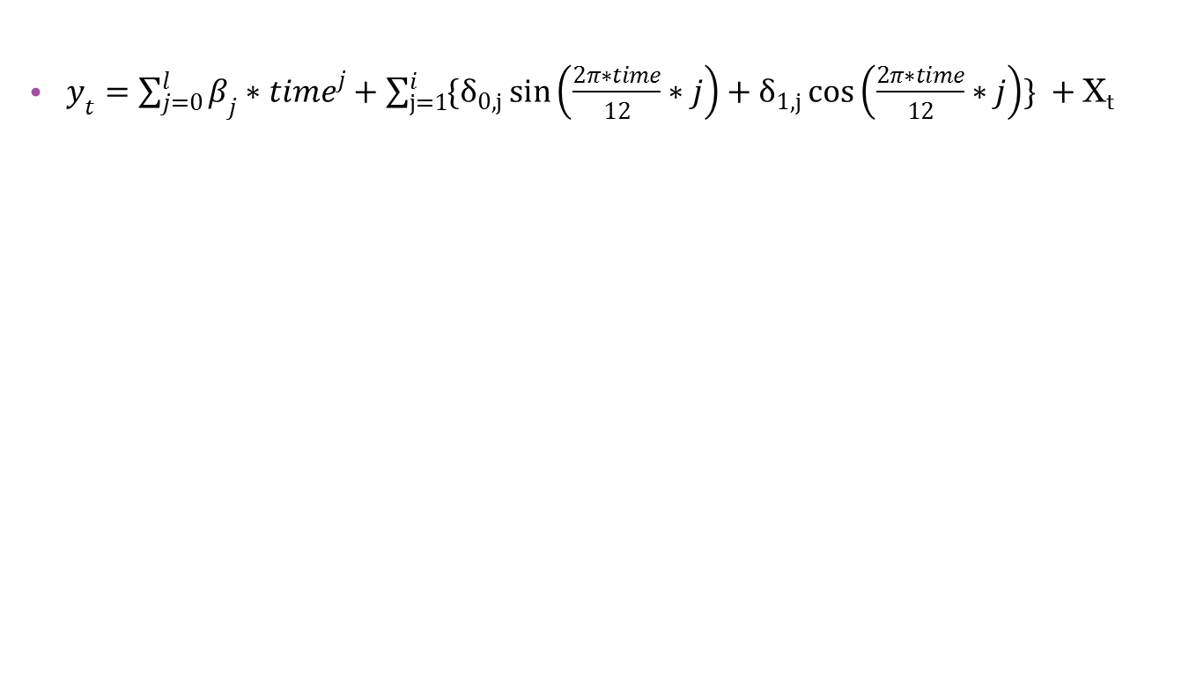
MODEL EQUATION
$y_{t}=\sum_{j=0}^{l}{β_{j}{∗time}^{j}}+\sum_{j=1}^{i}{\{δ_{0,j}\sin\left(\frac{2π∗time}{12}∗j\right)+δ_{1,j}\cos\left(\frac{2π∗time}{12}∗j\right)\}} +$X_{t}
Trend
Seasonality

Slide 11
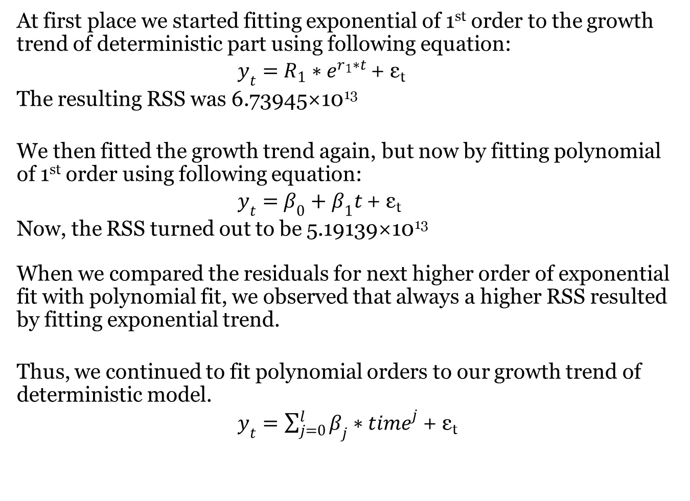
I. MODELING OF DETERMINISTIC PART
A) Polynomial Growth Trend

Slide 12
Estimation of parameters for different polynomial orders
Polynomial | First order (l=1) | Second order (l=2) | Third order (l=3) | Fourth order (l=4)
Total Number of parameters | 2 | 3 | 4 | 5
β₀ | 4927428 ± 215188.988 | 5234084 ± 319481.9404 | 4816612 ± 419923.336 | 4591730 ± 532444.0156
β₁ | 14185 ± 2786.6888 | 556 ± 11007.0268 | 37256 ± 27037.6316 | 69727 ± 54619.1632
β₂ |  | 102 ± 79.576 | -580 ± 467.9108 | -1661 ± 1648.7716
β₃ |  |  | 3 ± 2.2932 | 16 ± 18.4632
β₄ |  |  |  | 0 ± 0.0588
Residual sum of Squares | 5.19139×10¹³ | 4.95228×10¹³ | 4.64972×10¹³ | 4.58542×10¹³

Slide 13
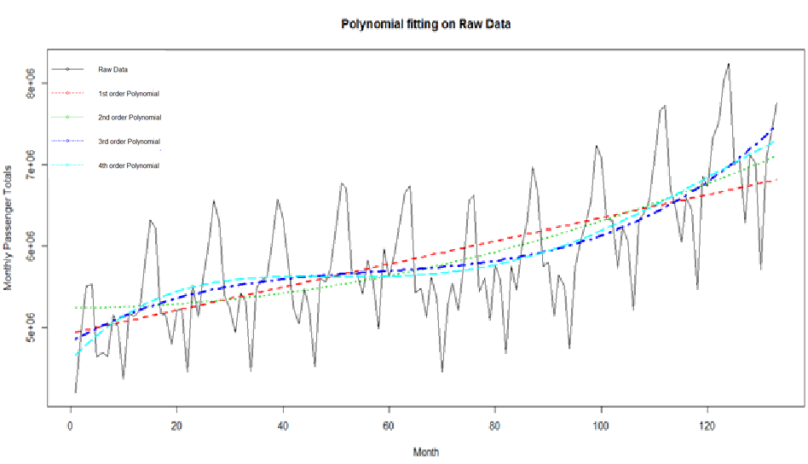
RSS: 5.19139×10¹³
RSS: 4.95228×10¹³
RSS: 4.64972×10¹³
F Test
RSS: 4.58542×10¹³

Slide 14
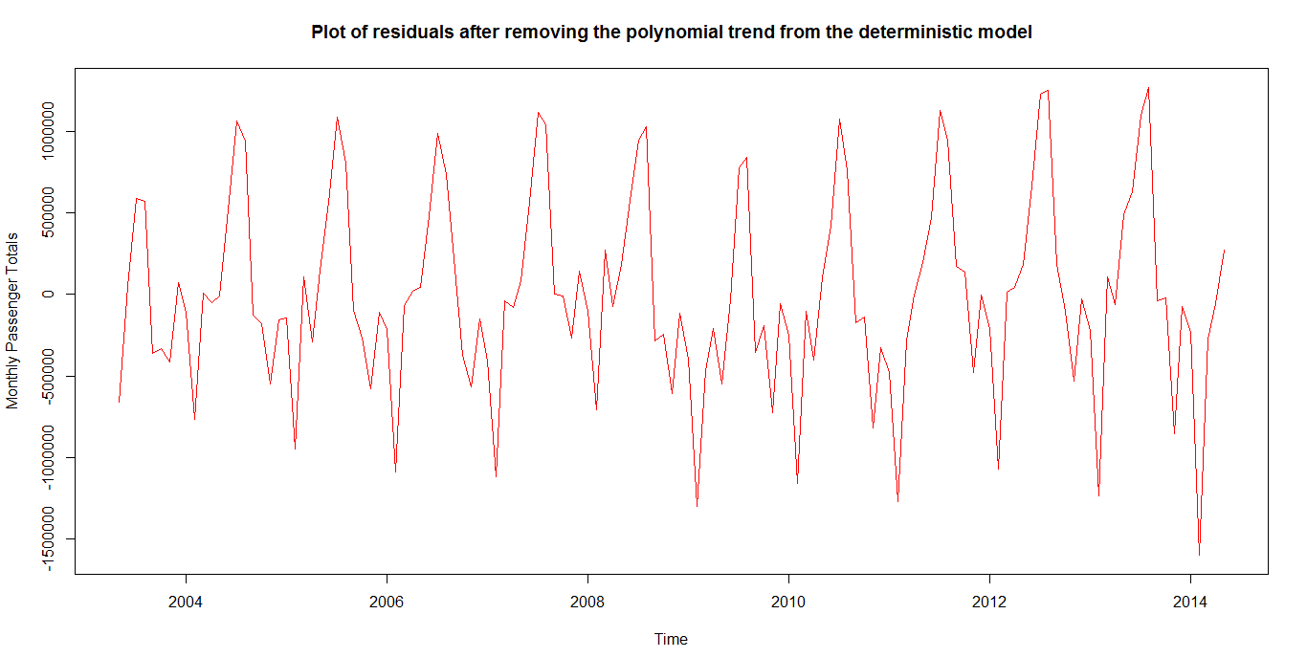

B) Addition of Periodic Trends
The first model we started fitting was,
Where,

Slide 15
i | 1 | 2 | 3 | 4 | 5 | 6
β₀ | 4642116 ± 278815.7 | 4617139 ± 250980.5 | 4641940 ± 207262.3 | 4651502 ± 185613.7 | 4641879 ± 139869 | 4642261 ± 140275.2
β₁ | 48286 ± 17953.6 | 50073 ± 16160.63 | 48578 ± 13344.8 | 48176 ± 11950.1 | 48652 ± 9004.338 | 48613 ± 9029.72
β₂ | -765 ± 310.6796 | -798 ± 279.6528 | -774 ± 230.9076 | -770 ± 206.78 | -776 ± 155.8004 | -775 ± 156.8
β₃ | 4 ± 1.5288 | 4 ± 1.372 | 4 ± 1.1368 | 4 ± 1.0192 | 4 ± 0.7644 | 4 ± 0
δ_{0,1} | 635645 ±96072.1636 | 637722 ±86384.4716 | 637580 ±71304.8 | 638738 ±63845.3732 | 638061 ±48105.28 | 637824 ±48239.52
δ_{1,1} | -340740 ±95386.7712 | -33605 ±85771.4228 | -31771 ±70803.334 | -29595 ±63397.964 | -31196 ±47770.34 | -301910 ±47967.08
δ_{0,2} |  | 24455 ±85635.7124 | 25540 ±70691.32 | 27674 ±63297.7296 | 26216 ±47694.88 | 241320 ±48012.16
δ_{1,2} |  | -247562 ±86007.348 | -246375 ±70994.66 | -245096 ±63566.3476 | -246054 ±47895.05 | -245006 ±48090.56
δ_{0,3} |  |  | -109326 ±70537.38 | -106834 ±63161.392 | -108579 ±47593.27 | -111346 ±48057.24
δ_{1,3} |  |  | 259546 ±71069.2864 | 259569 ±63631.6352 | 259511 ±47943.15 | 259670 ±48076.84
δ_{0,4} |  |  |  | -137442 ±63273.11 | -138971 ±47676.35 | -137759 ±47900.44
δ_{1,4} |  |  |  | 121697 ±63497.02 | 122541 ±47842.82 | 122779 ±47976.88
δ_{0,5} |  |  |  |  | -108820 ±47837.68 | -109224 ±47974.92
δ_{1,5} |  |  |  |  | -210257 ±47674.53 | -209699 ±47816.16
δ_{0,6} |  |  |  |  |  | 128402 ±27783.59
δ_{1,6} |  |  |  |  |  | -160800 ±41310.92
Residual sum of squares | 1.99863×10¹³ | 1.59029×10¹³ | 1.06618×10¹³ | 0.840801×10¹³ | 0.469419×10¹³ | 0.464074×10¹³

Slide 16
Period | F-statistic | F-critical
i = 1 | - | -
i = 2 | 16.0478 | 3
i = 3 | 30.2322 | 3
i = 4 | 16.2173 | 3
i = 5 | 47.07336 | 3
i = 6 | 0.67384 | 3
<
F-test indicated that adding the sixth period does not result in significant improvement and therefore we stop at i = 5.
As we can see, the trend appears to be best modeled with an order 3 polynomial, plus sine and cosine functions with periodicity 12, 6, 4, 3 and 2.4.
The introduction of these five periods accounts for yearly, half-yearly, 4 monthly, quarterly, and 2-2/5 monthly periods. It was therefore natural that periods smaller than 2-2/5 monthly may not be necessary.

Slide 17
Upon inspection of the parameters of the selected model (i = 5) and their respective p-values, we observed that cosine parameter of 1st period (δ_{1,1}) and sine parameter of 2nd period (δ_{0,2}) had p-value greater than 0.05 indicating their insignificance.
Table below shows estimation of parameters of the reduced model.
 | i=5 | P value | i=5 (Eliminating δ_{1,1} and δ_{0,2}) | P value
β₀ | 4641879 ± 139869 | 0.0000 | 4647563 ± 140147.2 | 0.0000
β₁ | 48652 ± 9004.338 | 0.0000 | 48266 ± 9021.331 | 0.0000
β₂ | -776 ± 155.8004 | 0.0000 | -769 ± 156.0748 | 0.0000
β₃ | 4 ± 0.7644 | 0.0000 | 4 ± 0.7644 | 0.0000
δ_{0,1} | 638061 ± 48105.28 | 0.0000 | 637756 ± 48253.73 | 0.0000
δ_{1,1} | -31196 ± 47770.34 | 0.2030 | - | -
δ_{0,2} | 26216 ± 47694.88 | 0.2835 | - | -
δ_{1,2} | -246054 ± 47895.05 | 0.0000 | -245951 ± 48045.13 | 0.0000
δ_{0,3} | -108579 ± 47593.27 | 0.0000 | -108633 ± 47737.23 | 0.0000
δ_{1,3} | 259511 ± 47943.15 | 0.0000 | 259598 ± 48094.7 | 0.0000
δ_{0,4} | -138971 ± 47676.35 | 0.0000 | -138993 ± 47822.35 | 0.0000
δ_{1,4} | 122541 ± 47842.82 | 0.0000 | 122612 ± 47987.22 | 0.0000
δ_{0,5} | -108820 ± 47837.68 | 0.0000 | -108827 ± 47820.32 | 0.0000
δ_{1,5} | -210257 ± 47674.53 | 0.0000 | -210198 ± 47674.53 | 0.0000
RSS | 0.469419×10¹³ |  | 0.480334×10¹³

Slide 18
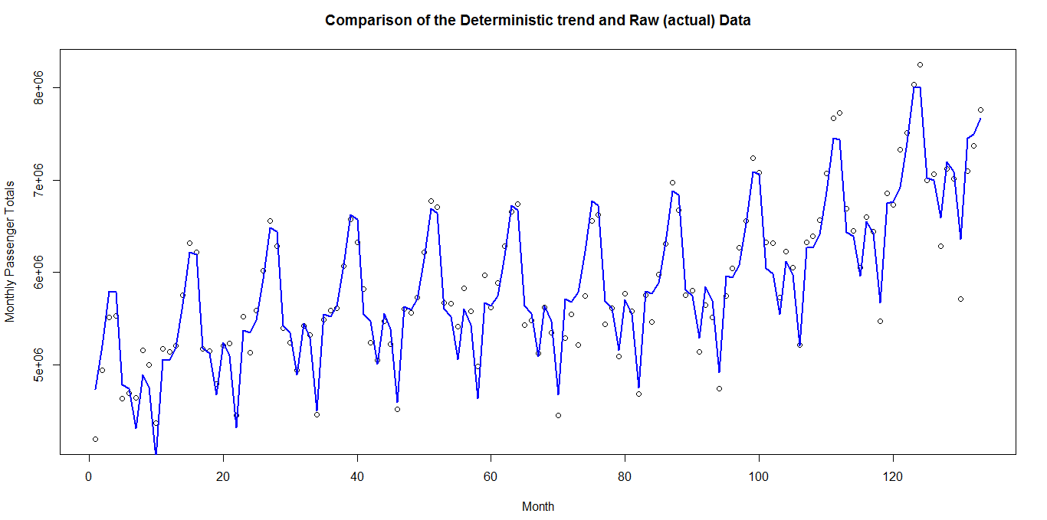
The fit of this deterministic component is pictorially represented by a solid blue line, the original data are shown by black dots.
Figure below also confirms the adequacy of the deterministic part of the model.

Slide 19
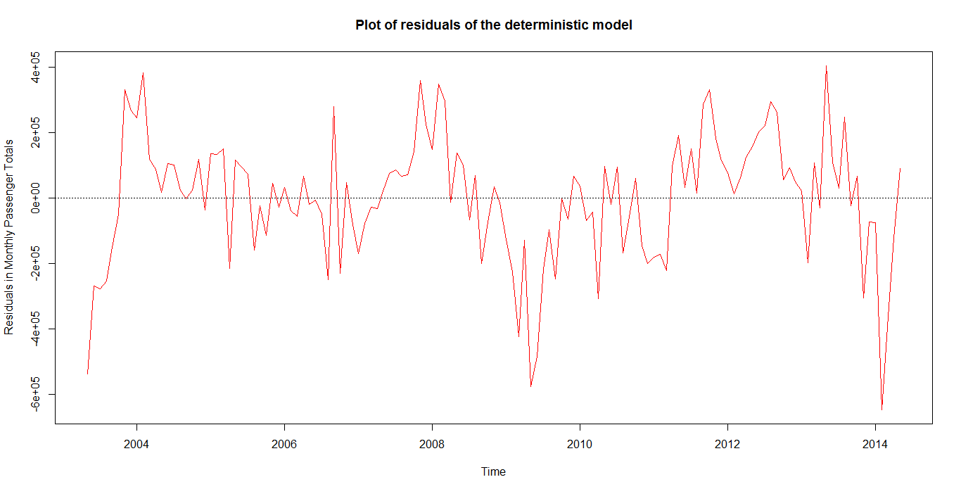
II] MODELING OF STOCHASTIC PART

Slide 20
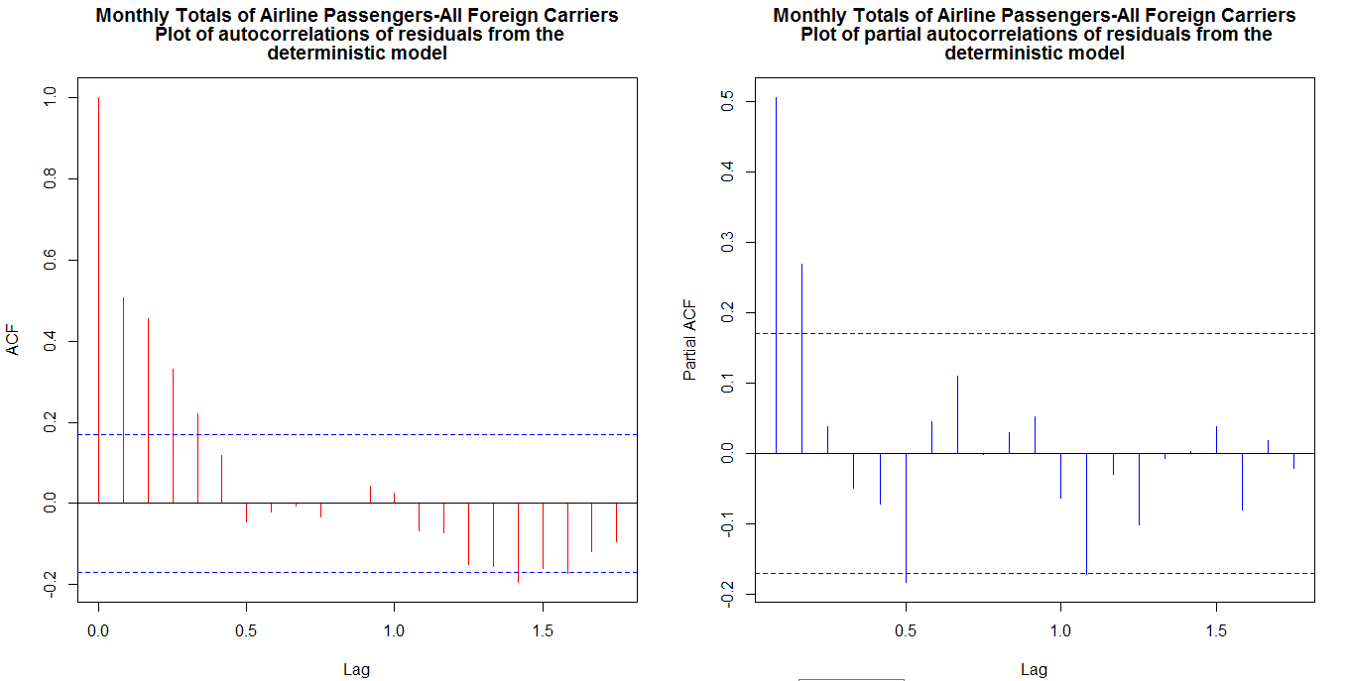
Both graphs as seen have a few significant lags but the autocorrelations die out asymptotically, so we can conclude that our series is stationary.
Augmented Dicker-Fuller (ADF) t-statistic test in RStudio using function adf.test () also indicated stationarity of the residuals.
Thus, the residuals can be considered as the stochastic part of the final model and the modeling procedure of ARMA is now applicable.

Slide 21
ARMA MODELING
ARMA (2, 1) Vs ARMA (4, 3) → F test (Significant)
ARMA (4, 3) Vs ARMA (6, 5) → F test (Insignificant)
ARMA (3, 2) Vs ARMA (4, 3) → F test (Insignificant)
ARMA (3, 1) Vs ARMA (3,2) → F test (significant)
ARMA (2, 2) Vs ARMA (3,2) → F test (Insignificant)
Selecting ARMA (2, 2)

Slide 22
Estimation of parameters of ARMA model
Parameters | ARMA (2,1) | ARMA (4,3) | ARMA (6,5) | ARMA (3,2) | ARMA (2,2)
Φ₁ | 0.4896 ± 0.473 | 1.3634 ± 0.958 | 0.0305 ± 1.116 | 1.5757 ± 0.222 | 1.5169 ± 0.234
Φ₂ | 0.2346 ± 0.298 | -0.6955 ± 1.539 | -0.0987 ± 0.903 | -1.0066 ± 0.533 | -0.7354 ± 0.217
Φ₃ |  | -0.148 ± 1.125 | 0.2544 ± 0.914 | 0.1969 ± 0.382
Φ₄ |  | 0.188 ± 0.318 | -0.0828 ± 0.879
Φ₅ |  |  | -0.3387 ± 0.777
Φ₆ |  |  | 0.0942 ± 0.409
θ₁ | 0.1137 ± 0.476 | 1.0777 ± 0.966 | -0.3118 ± 1.098 | 1.2582 ± 0.134 | 1.2427 ± 0.206
θ₂ |  | -0.6963 ± 1.264 | -0.5216 ± 0.519 | -0.8567 ± 0.319 | -0.7262 ± 0.193
θ₃ |  | -0.2319 ± 0.959 | -0.1043 ± 1.074
θ₄ |  |  | -0.4550 ± 0.668
θ₅ |  |  | -0.6628 ± 1.034
Mean (µ) | -10790.5 ± 83412.41 | -3299.62 ± 71402.49 | -2596.49 ± 64878.94 | -1668.48 ± 64655.22 | 1521.14 ± 56504.6
Residual Sum of Squares | 3.20881×10¹² | 2.84846×10¹² | 2.73525×10¹² | 2.97485×10¹² | 3.01396×10¹²

Slide 23
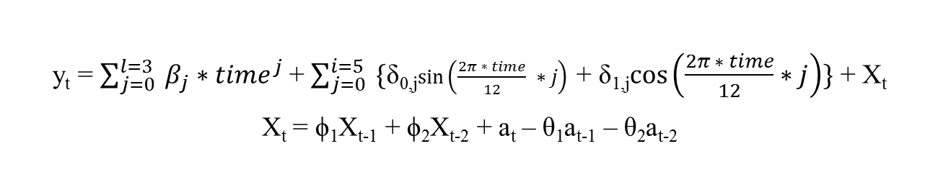
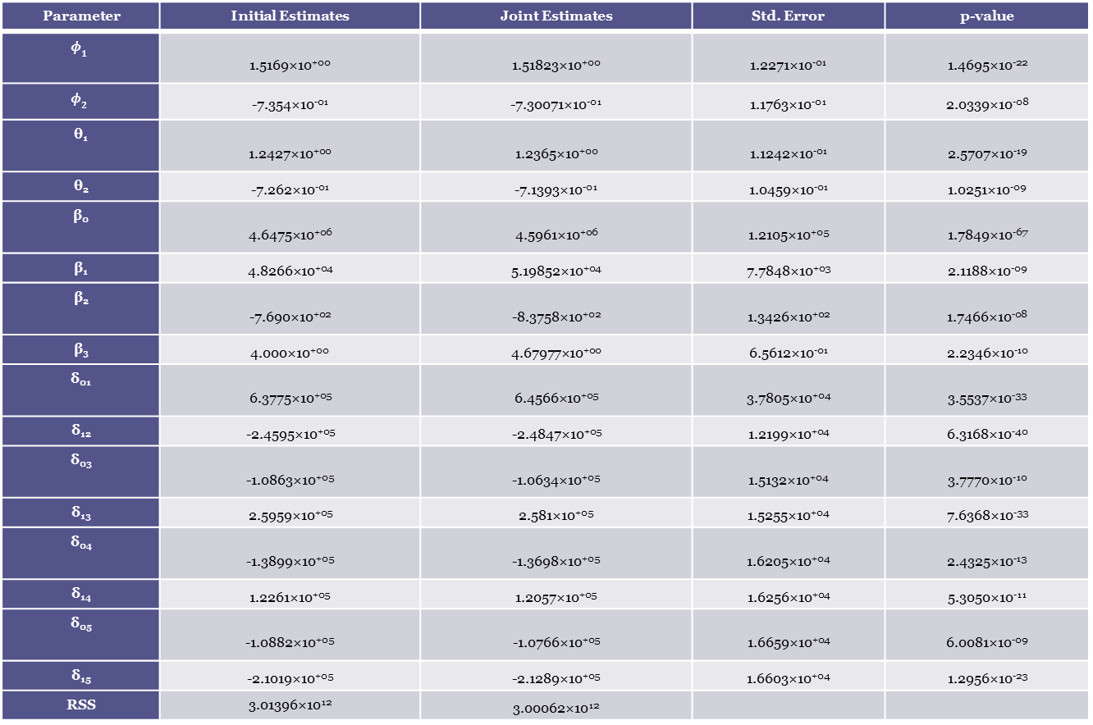
III] Joint Optimization
Parameter | Initial Estimates | Joint Estimates | Std. Error | p-value
 | 1.5169×10⁺⁰⁰ | 1.51823×10⁺⁰⁰ | 1.2271×10⁻⁰¹ | 1.4695×10⁻²²
 | -7.354×10⁻⁰¹ | -7.30071×10⁻⁰¹ | 1.1763×10⁻⁰¹ | 2.0339×10⁻⁰⁸
θ₁ | 1.2427×10⁺⁰⁰ | 1.2365×10⁺⁰⁰ | 1.1242×10⁻⁰¹ | 2.5707×10⁻¹⁹
θ₂ | -7.262×10⁻⁰¹ | -7.1393×10⁻⁰¹ | 1.0459×10⁻⁰¹ | 1.0251×10⁻⁰⁹
β₀ | 4.6475×10⁺⁰⁶ | 4.5961×10⁺⁰⁶ | 1.2105×10⁺⁰⁵ | 1.7849×10⁻⁶⁷
β₁ | 4.8266×10⁺⁰⁴ | 5.19852×10⁺⁰⁴ | 7.7848×10⁺⁰³ | 2.1188×10⁻⁰⁹
β₂ | -7.690×10⁺⁰² | -8.3758×10⁺⁰² | 1.3426×10⁺⁰² | 1.7466×10⁻⁰⁸
β₃ | 4.000×10⁺⁰⁰ | 4.67977×10⁺⁰⁰ | 6.5612×10⁻⁰¹ | 2.2346×10⁻¹⁰
δ₀₁ | 6.3775×10⁺⁰⁵ | 6.4566×10⁺⁰⁵ | 3.7805×10⁺⁰⁴ | 3.5537×10⁻³³
δ₁₂ | -2.4595×10⁺⁰⁵ | -2.4847×10⁺⁰⁵ | 1.2199×10⁺⁰⁴ | 6.3168×10⁻⁴⁰
δ₀₃ | -1.0863×10⁺⁰⁵ | -1.0634×10⁺⁰⁵ | 1.5132×10⁺⁰⁴ | 3.7770×10⁻¹⁰
δ₁₃ | 2.5959×10⁺⁰⁵ | 2.581×10⁺⁰⁵ | 1.5255×10⁺⁰⁴ | 7.6368×10⁻³³
δ₀₄ | -1.3899×10⁺⁰⁵ | -1.3698×10⁺⁰⁵ | 1.6205×10⁺⁰⁴ | 2.4325×10⁻¹³
δ₁₄ | 1.2261×10⁺⁰⁵ | 1.2057×10⁺⁰⁵ | 1.6256×10⁺⁰⁴ | 5.3050×10⁻¹¹
δ₀₅ | -1.0882×10⁺⁰⁵ | -1.0766×10⁺⁰⁵ | 1.6659×10⁺⁰⁴ | 6.0081×10⁻⁰⁹
δ₁₅ | -2.1019×10⁺⁰⁵ | -2.1289×10⁺⁰⁵ | 1.6603×10⁺⁰⁴ | 1.2956×10⁻²³
RSS | 3.01396×10¹² | 3.00062×10¹²
y_{t} = $\sum_{j=0}^{l=3}{ β_{j}{∗time}^{j}}$ + $\sum_{j=0}^{i=5}{ \{}$δ_{0,j}$\sin\left(\frac{2π ∗ time}{12} ∗j\right)$ + δ_{1,j}$\cos\left(\frac{2π ∗ time}{12}∗j\right)\}$ + X_{t}
X_{t} = ϕ₁X_{t-1} + ϕ₂X_{t-2} + a_{t} – θ₁a_{t-1} – θ₂a_{t-2}

Slide 24
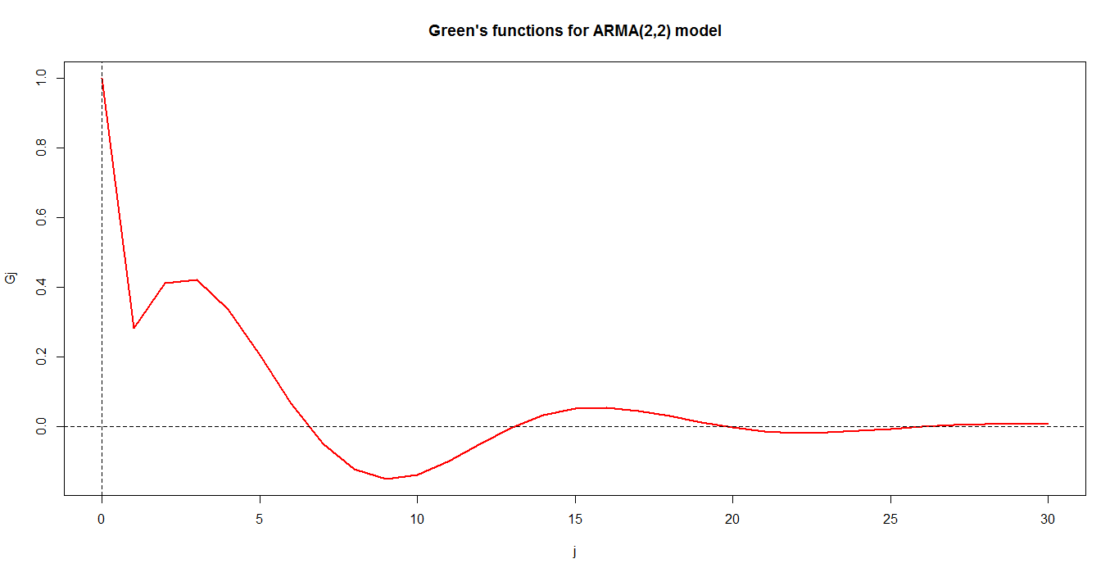
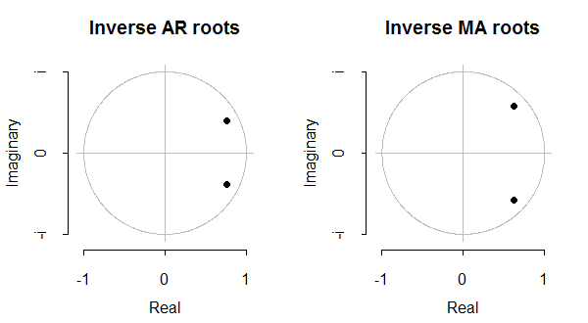
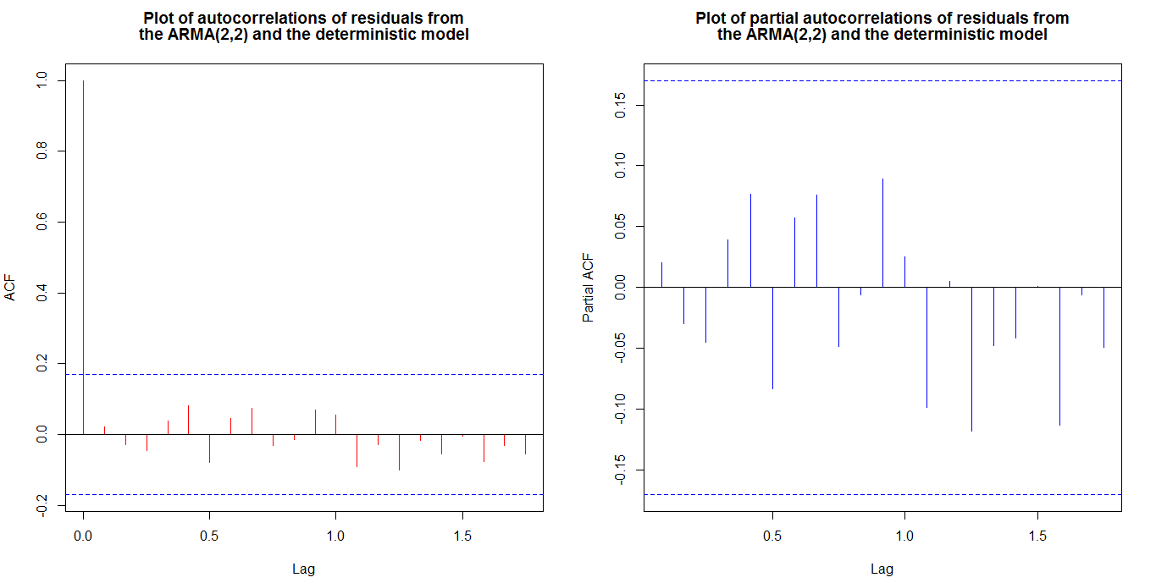
Model diagnosis:-

Slide 25
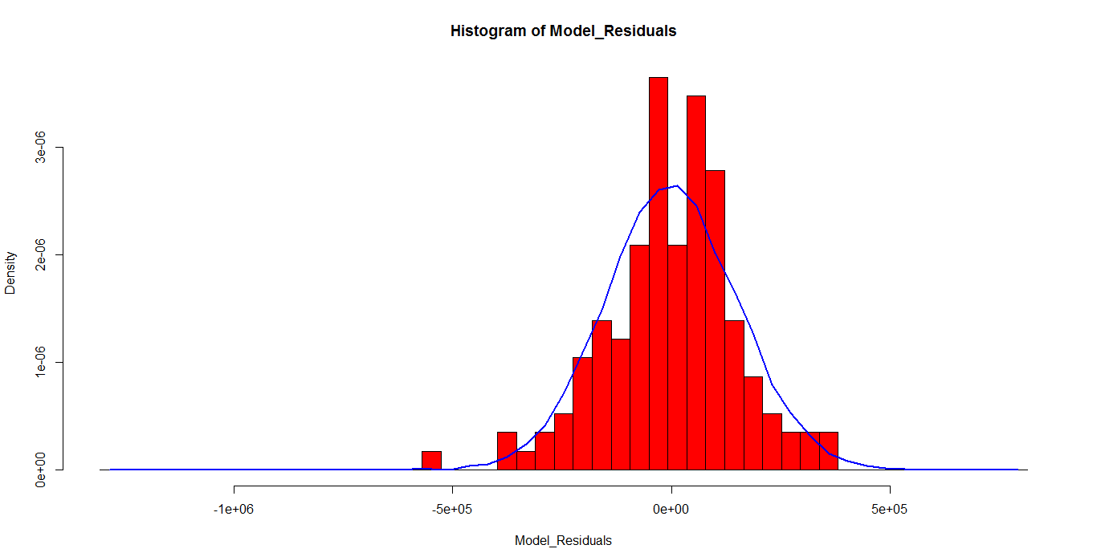
Normality of residuals:-

Slide 26
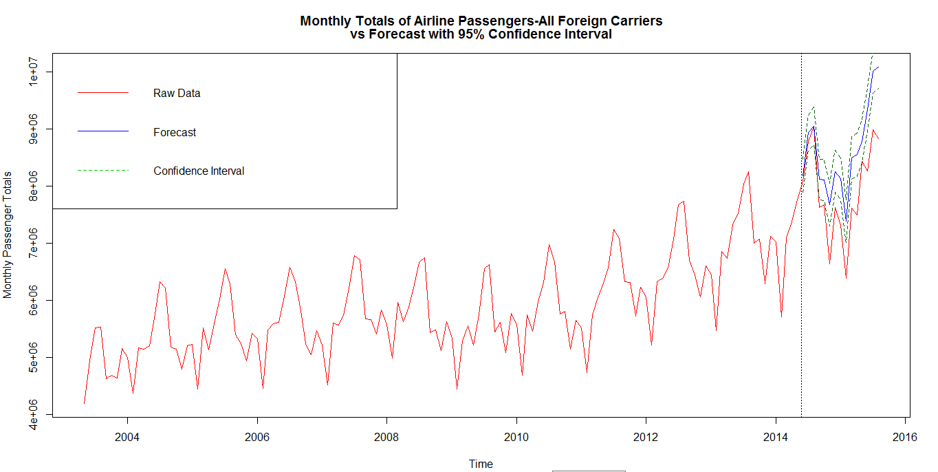
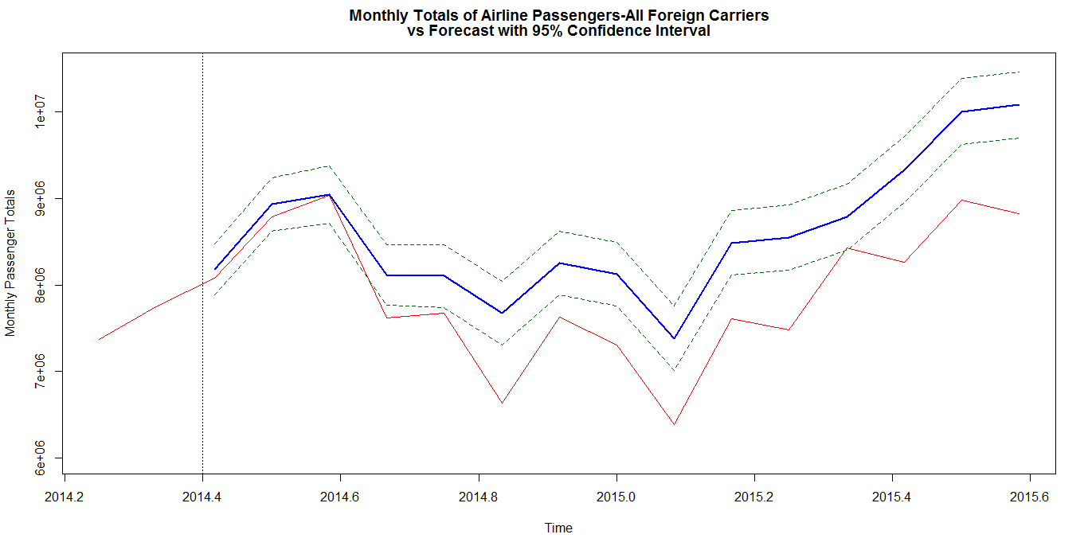
Forecasting:-

Slide 27
Forecasting Errors
Month | Actual Data | Forecast | Error | Percentage Error (%)
06/2014 | 8079300 | 8176056 | -96756 | -1.1976
07/2014 | 8783220 | 8930582 | -147362 | -1.6777
08/2014 | 9038255 | 9046370 | -8115 | -0.0898
09/2014 | 7619465 | 8113469 | -494004 | -6.4834
10/2014 | 7673417 | 8102393 | -428976 | -5.5904
11/2014 | 6638808 | 7672084 | -1033276 | -15.5642
12/2014 | 7626128 | 8253149 | -627021 | -8.222
01/2015 | 7308423 | 8123713 | -815290 | -11.1555
02/2015 | 6387635 | 7383198 | -995563 | -15.5858
03/2015 | 7608260 | 8486925 | -878665 | -11.5488
04/2015 | 7484515 | 8544834 | -1060319 | -14.1668
05/2015 | 8431816 | 8783959 | -352143 | -4.1764
06/2015 | 8260661 | 9333629 | -1072968 | -12.9889
07/2015 | 8978879 | 10004471 | -1025592 | -11.4223
08/2015 | 8823253 | 10081040 | -1257787 | -14.2554
 |  |  | MAE = 686256 | MAPE = 8.9417 %

Slide 28
Conclusion:-
We have done the modeling over a raw data by fitting the extracted deterministic & stochastic part.
The forecasted values should be updated instantly in order to get the best possible predictions.
This forecasted values can help as a leading indicator to forecast other time series to enhance the performance of business decisions.

Slide 29
Thank you

